Slide 1

Decision Support and Business Intelligence
ALY 6060
Instructor: Mykhaylo Trubskyy
Ajay Deshpande
Jingjing Fan
Sairandhri Sett
June 25, 2024

Slide 2

Agenda
Introduction
Data Collection and Cleanising
OTT Industry Analysis
OTT Platforms and Pricing
Netflix: Originals Story
Netflix Originals Comparision
Growth of Netflix
Further Analysis
Conclusion

Slide 3
Introduction
Over-The-Top (OTT) media services provide media content directly to viewers via the internet, bypassing traditional cable and satellite providers.
OTT platforms have developed from basic video-on-demand services into extensive entertainment hubs, offering movies, TV shows, live sports, and original content.
Popular OTT platforms for streaming movies and shows include Amazon Prime Video, Netflix, Hulu, Disney+, and Apple TV.
These platforms offer tiered content, providing enhanced services and exclusive content to paid and subscribed consumers.

Slide 4
Data Collection and Cleaning (1)
The data has been collected from multiple websites
Kaggle – Data on movies and userbase on various OTT Platforms
Statista – Netflix data regarding subscribers, and OTT Platforms' Comparision
Macrotrends – Netflix Revenue and Profit data
The data has been collected by scraping, making API calls and manually exporting data as excel files

Slide 5
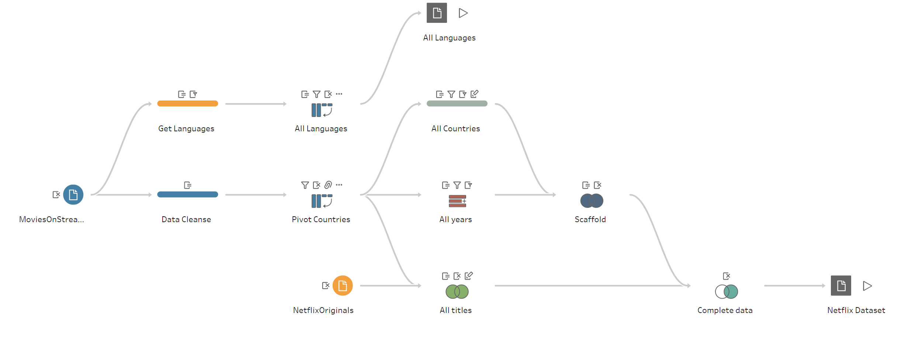
Data Collection and Cleaning (2)
The data cleaning processing involves applying row level filters to remove null data, performing pivot, calculating new fields and creating joins.

Slide 6
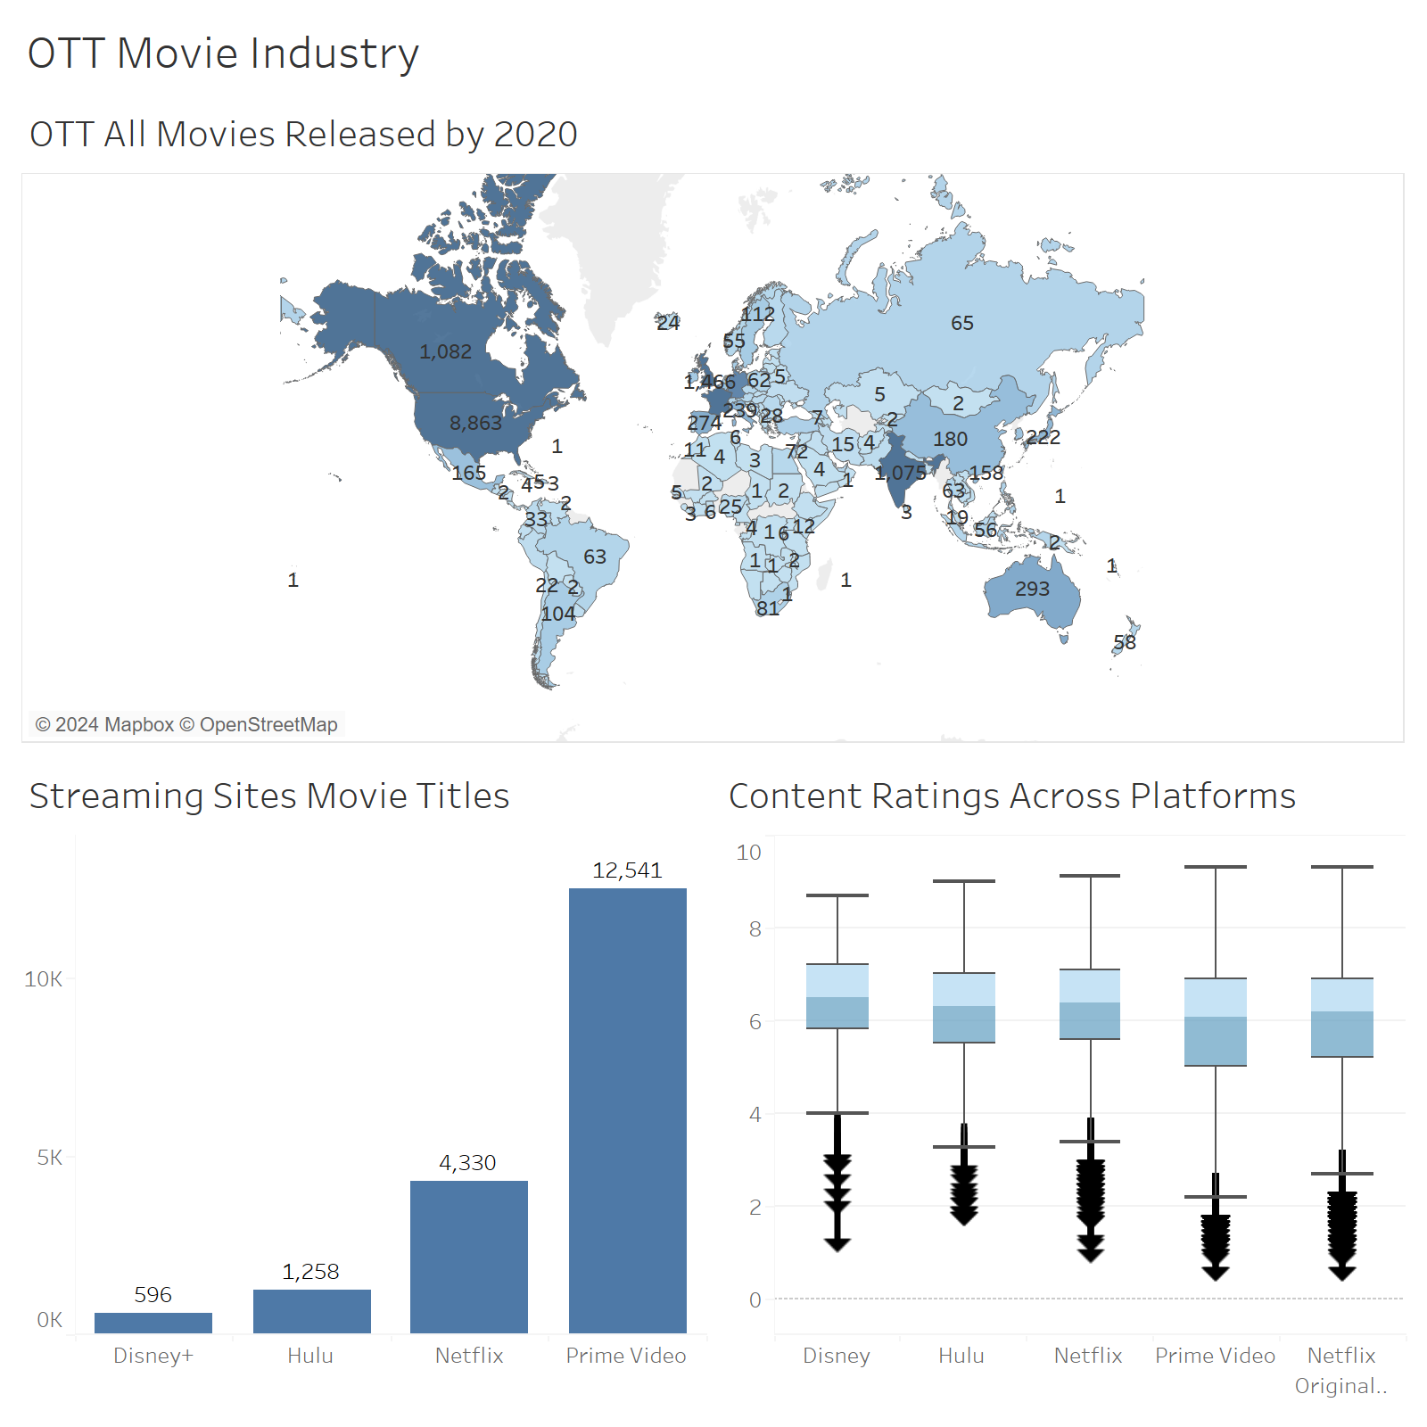
OTT Industry Analysis
United States, Canada, United Kingdom and India are the major countries for movie offerings on OTT platform
Prime Video is the leading in number of movies offered on OTT followed by Netflix
The content offered across platforms have similar ratings
Netflix Originals has movies with highest ratings of 10 and has a higher median rating score of 6.63

Slide 7
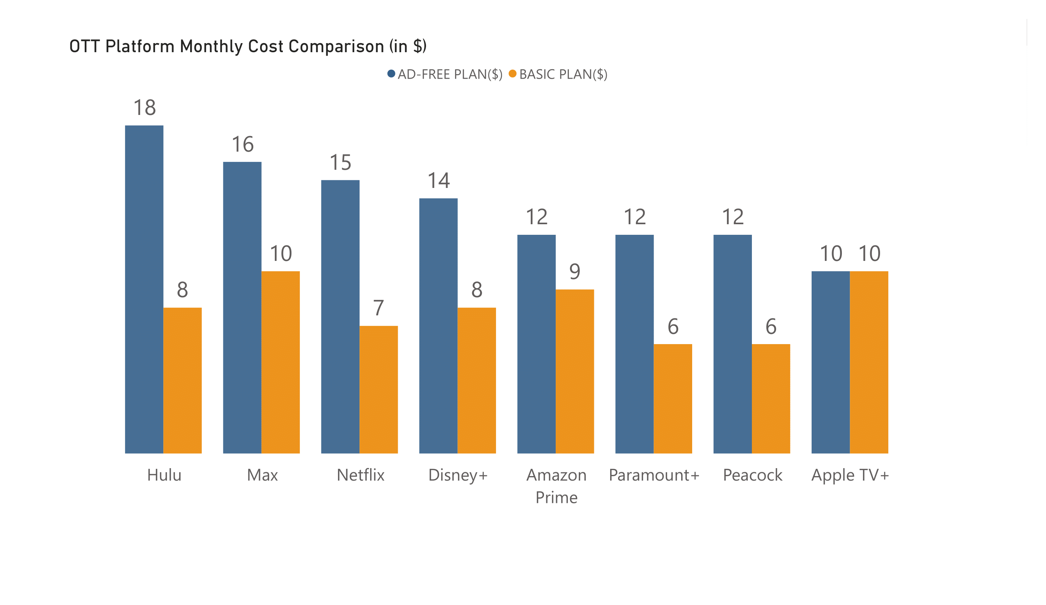
Netflix's ad-free plan ($15) is cheaper than Hulu ($18) and Max ($16).
Netflix's basic plan ($7) is lower than most of the other leading OTT platforms in the market.

Slide 8
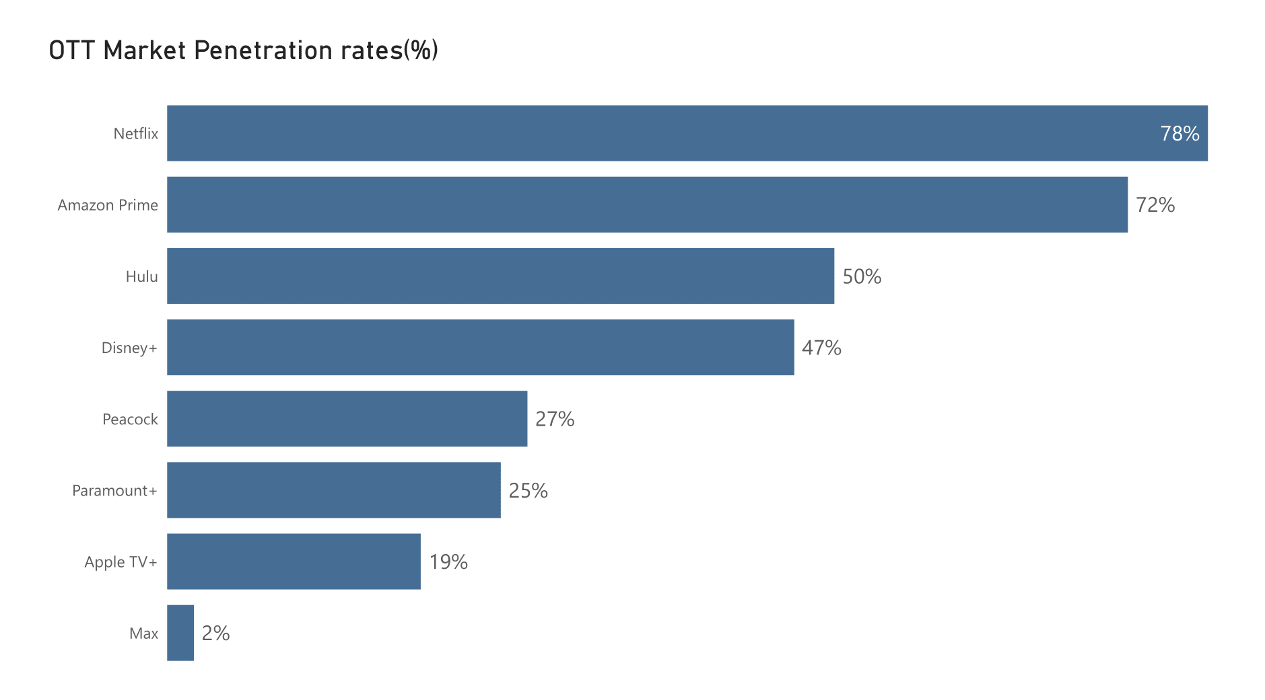
Netflix leads with 78% market penetration.
Amazon Prime follows with 72%, while Hulu holds a solid 50% penetration, reflecting competitive positions within the OTT industry.

Slide 9
Netflix originals
Netflix Originals are exclusive content produced or commissioned by Netflix, including TV series, movies, documentaries, and stand-up specials. These originals have become a cornerstone of Netflix's strategy, driving subscriber growth and establishing the platform as a leading content creator in the entertainment industry.
Launched original content with "House of Cards" in 2011, transforming from a streaming service to a content creator
Produces content in multiple languages, achieving international acclaim with shows like "Money Heist" and "Sacred Games"

Slide 10
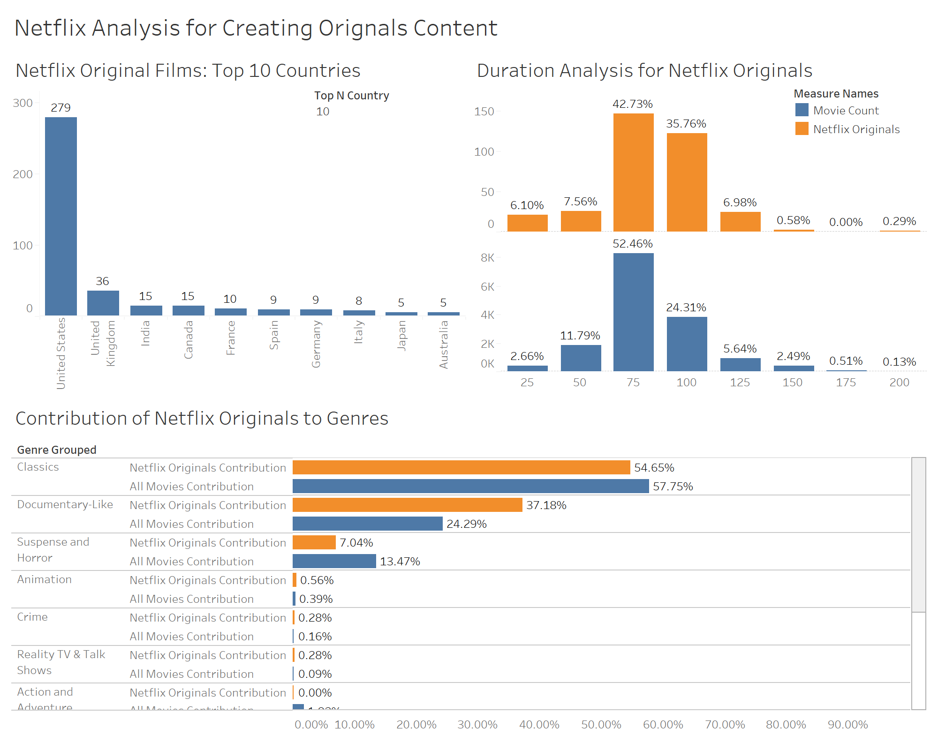
Netflix Originals: Data-Driven Content Creation
Netflix uses viewer data to tailor content, resulting in highly successful and engaging series and movies
Comparing the Movie industry and Netflix Originals Films reveals a similar trend across genres and duration
United States have highest number of "Originals" content

Slide 11
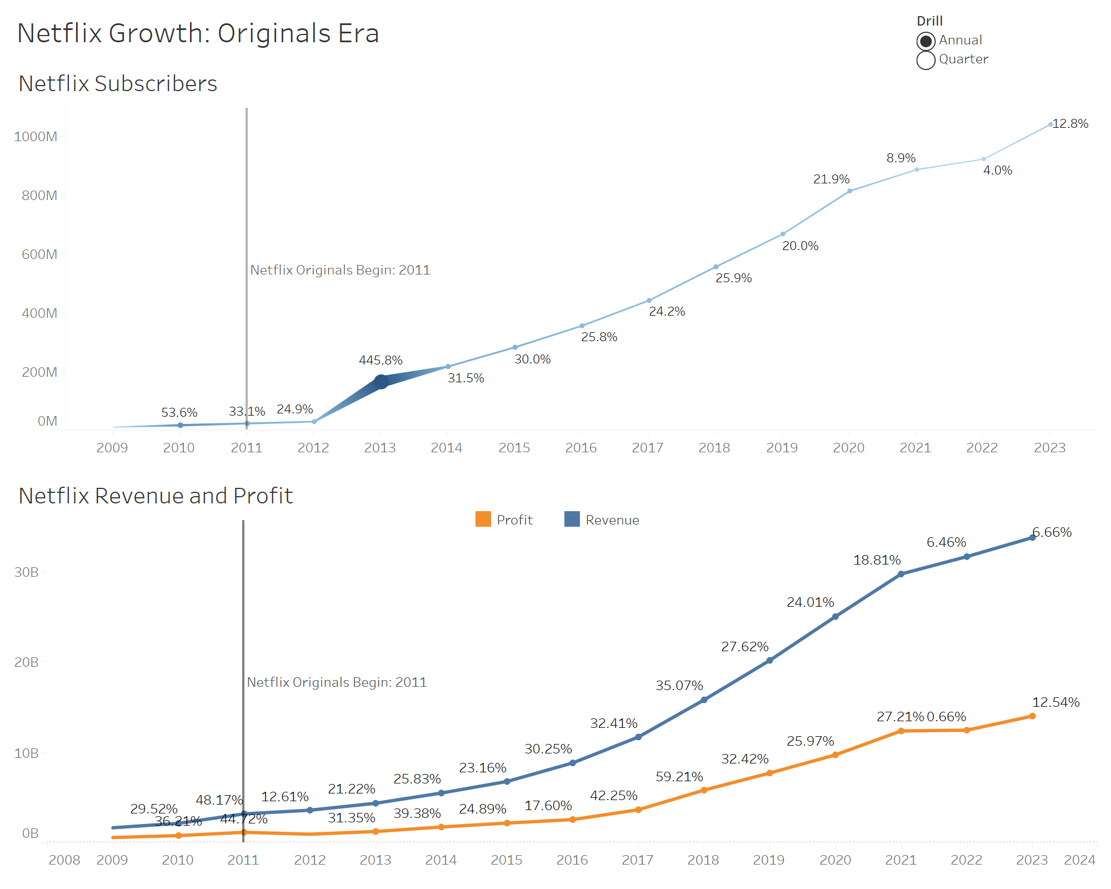
NETFLIX GROWTH
Pre-Originals (Till 2011): Moderate increase in subscribes of 53.6% in 2010, 33.1% in 2011
Significant surge after 2011 launch of Originals with a peak growth of 445.8% in 2012
Steady annual growth in subscribers, profit and revenue of about 25%-35% ever since

Slide 12
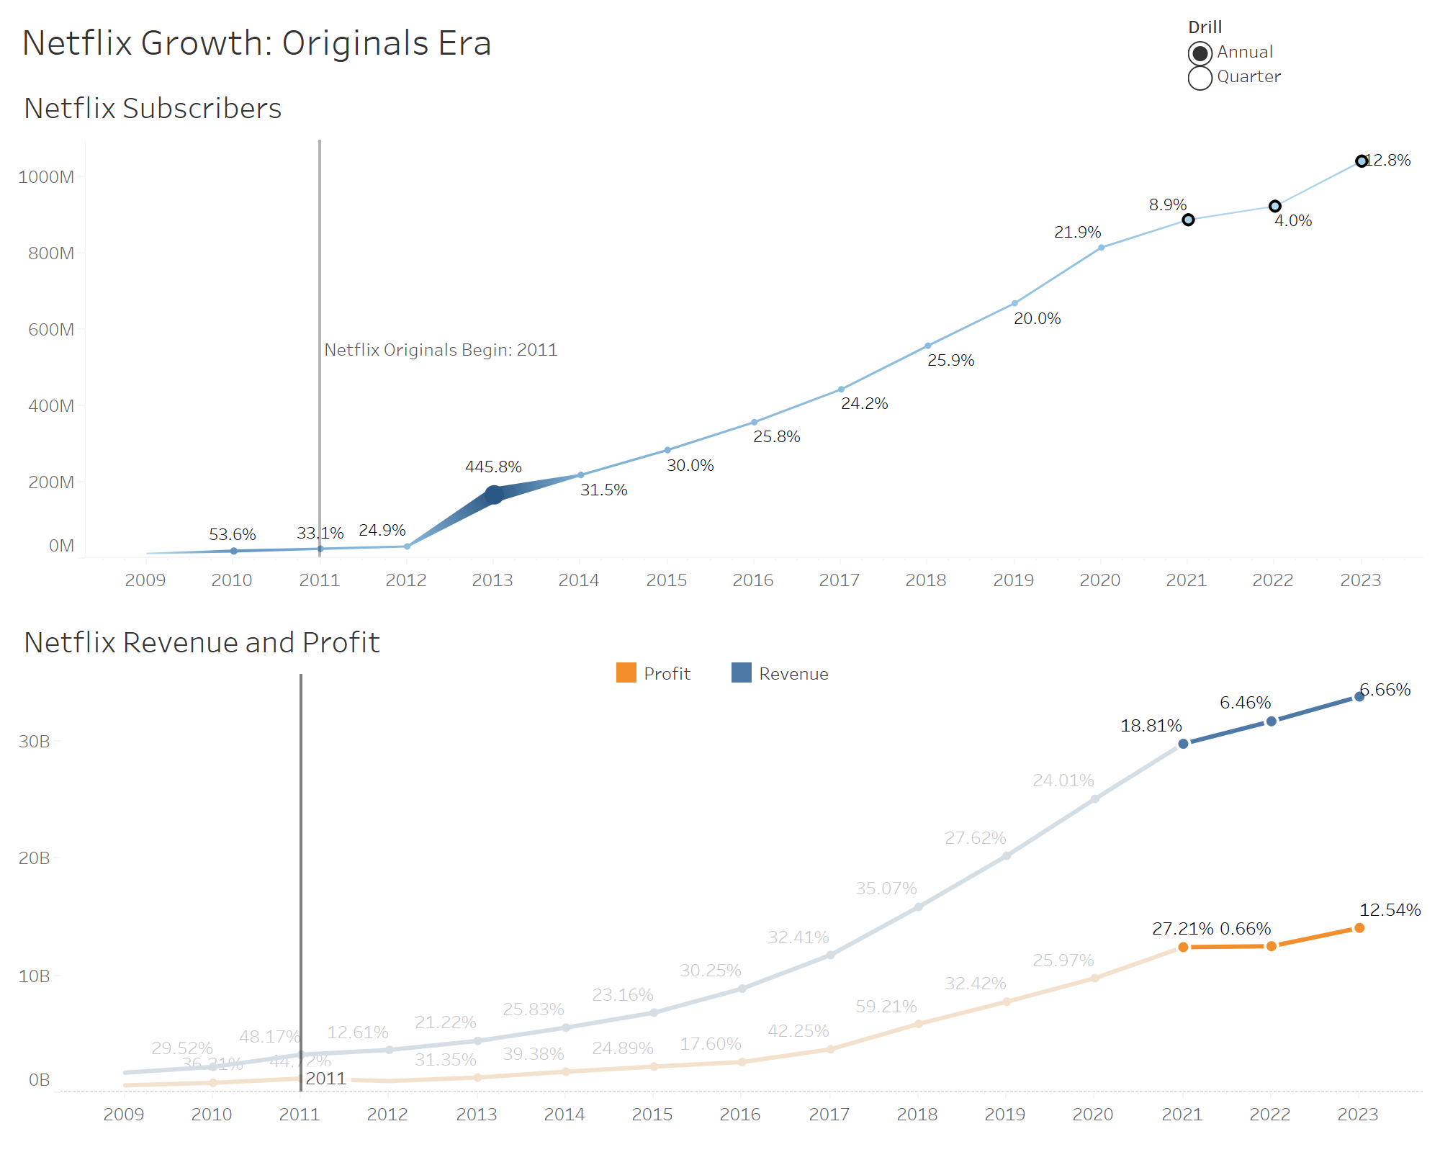
Prospects
A look into the highlighted points show that Netflix growth has stunted in the recent times
Further analysis is required before concluding with concrete evidence
Some news regarding shedding light on this flatlined growth is regional market in India suffered a big hit due to compliance issues
Too many competitors providing cheaper regional content

Slide 13
References
https://www.macrotrends.net/stocks/charts/NFLX/netflix/
https://www.statista.com/topics/842/netflix/#topicOverview
https://www.kaggle.com/datasets/arnavsmayan/netflix-userbase-dataset
https://www.kaggle.com/datasets/shivamb/netflix-shows
https://www.kaggle.com/datasets/ruchi798/movies-on-netflix-prime-video-hulu-and-disney

Slide 14

Thank You!

